Slide 1
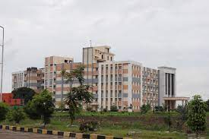

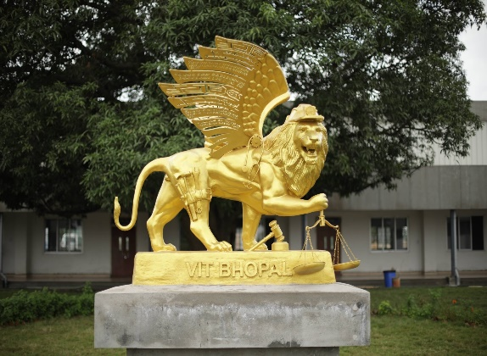
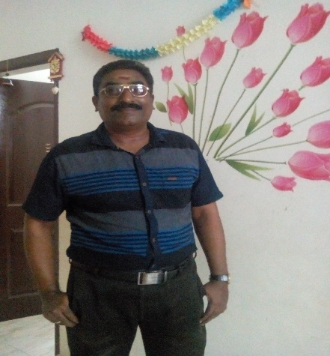
Welcome to
CSA2002 INTRODUCTION TO DRONES
G.GANESAN, B.E (CSE)., M.E (CSE)., M.S(IT).,MISTE.,
SENIOR TEACHING FELLOW,
SCHOOL OF CSE.
+91-9500234437
ganesan.g@vitbhopal.ac.in

Slide 2
Course Content
Date: 20-02-2023 Time: 10.05am – 11.35am
Photography
2. Controlling Camera
3. Recording Videos

Slide 3
Photography
Requirements:
Flight Controller (ArduPilot)
Frame (HobbyKing X930)
Batteries (2 LiPo – 5000 mAh)
Radio
Propellers (T-type 13x5.5 Carbon fiber)
Camera Mount or Gimbal
Camera
Other tools (Screwdrivers, Soldering iron, glue gun,
propeller balancer, jumpers, etc.)

Slide 4
Photography
Module-1: Preparing the drone for flying. Check the drone by flying
10 to 15 minutes before connecting the camera.
Module-2: Gimbal Choosing
- Select the type of gimbal depends on the camera size and
specification.
- Types of Gimbal – Standard and Brushless
Standard – Servo motors and gears, lightweight. (DSLR)
Brushless – Need external controller board, heavier,
used for professionals. (FPV)

Slide 5
Photography
Module-3: Configuring the Camera with the ArduPilot
a. Camera Gimbal’s from Euler angels:
- Tilt: Moves the camera in sloping position (range -90º to +90º)
Motion – Clockwise and Anticlockwise with the vertical axis.
- Roll: Motion ranging from 0º to 360º parallel to Horizontal axis.
- Pan: Motion ranging from 0º to 360º in Vertical axis.
- Shutter: A Switch that triggers a Click or Sends a Signal.

Slide 6
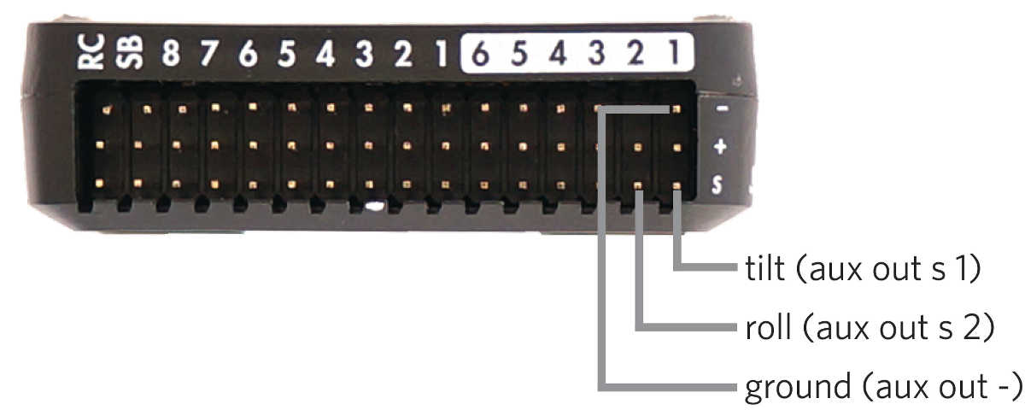
Photography
b. Using Standard Gimbal
- Two Servo motors in it. One for Pitch or Tilt, another for Roll.
- Two dimensional motion with the camera view point.

Slide 7
Photography
c. Gimbal configuration through Mission Planner
- Under the SETUP/Optional Hardware Menu, there is a Camera Gimbal
set-up screen.
- Select Servo in the Type box to set the type of gimbal.
It can be either non-stabilized manual control, or ArduPilot stabilization,
or External gimbal stabilizer.
- For each axis (TILT, ROLL, PAN) of the camera gimbal, Select the
appropriate output channel and ensure the appropriate “Stabilize”
checkbox is select.

Slide 8
Photography
c. Gimbal configuration through Mission Planner
- The Servo Limits should be adjusted to ensure the gimbal servos don’t
bind.
- The Angle Limits should correspond to the Tilt angle of the gimbal.
- Retract Angles – The position of the gimbal when the mount’s mode is
“retracted” (MNT_MODE=0). Retracted is when the gimbal is pulled
into the body of the drone, which is not relevant for multicopter.
- Control Angles – Parameters to allow control of the gimbal from
a ground station, no updation needed on the MP screen.

Slide 9
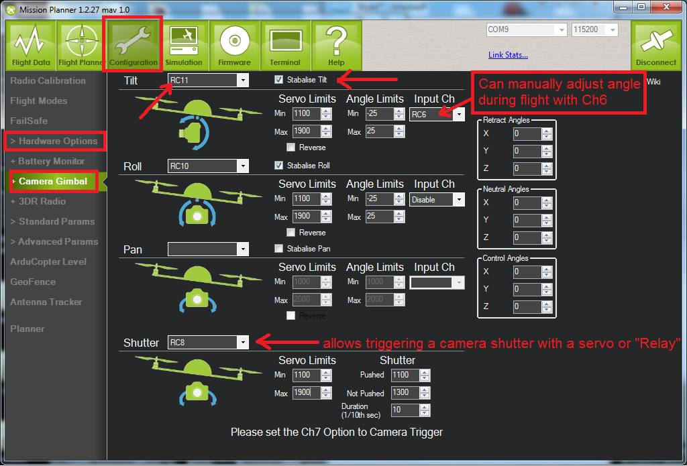
Photography – Setup Screen of camera & Gimbal

Slide 10
Photography
Suppose, if we find the gimbal is moving in the wrong
direction, check the “Reverse” checkbox.
If we want to adjust the gimbal Tilt, Roll, or Pan while the
drone flying, set up the following to the RC channel.
- MNT_RC_IN_TILT
- MNT_RC_IN_ROLL
- MNT_RC_IN_PAN

Slide 11
Photography
Aligning Min and Max PWM values in Servo
- Tilt airframe over hard left (nearly 45 deg) and raise the
“Roll” “Servo” “Min” value until the servo starts to
physically move a tiny bit, stop there.
- Tilt airframe over hard right (nearly 45 deg) and lower the
“Roll” “Servo” “Min” value until the servo starts to
physically move a tiny bit, stop there.
- Repeat for Pitch (Forward and Backward motion).

Slide 12
Photography
Leveling / Centering the Gimbal
- Keep the airframe perfectly straight and level.
- If the gimbal is not quite perfectly level
Tweak the hardware first (get servo horn’s, so that gimbal
is as close to level by unscrewing horn from servo and
repositioning it or using push-rods to the gimbal, adjust the
length)

Slide 13
Photography
Leveling / Centering the Gimbal
- If “Tilt” is still not quite level, trim it by
Tilt → Angle → Min and
Tilt → Angle → Max
adjust the “centre” position of the gimbal by small amount.

Slide 14
Photography
Common fixes for poor video
- “Jello” effect (or) rolling shutter is a by-product of using a camera with a CMOS sensor caused by vibration from unbalanced propellers/motors and can be mitigated by mounting the camera on soft rubber, silicone, foam ear plugs.
- Digital and optical stabilization systems found in many cameras often do not perform well because of the vibrations.
- For better and smoother Yaw, use Expo control on your RC
and lower the Acro_Yaw_P gain in the ArduPilot.

Slide 15
Discussion

Slide 16
Controlling Camera Gimbal using ESP8266
To control the camera, we can use two mechanism:
1. Shutter Pin 2. Mobile App
Shutter Pin: Manually used from the transmitter that connected with RC7 pin for controlling a servo. We can use servo or a receiver switch to trigger the shutter. For point and shoot the camera update the firmware of camera.
A receiver controller ON/OFF switch.

Slide 17
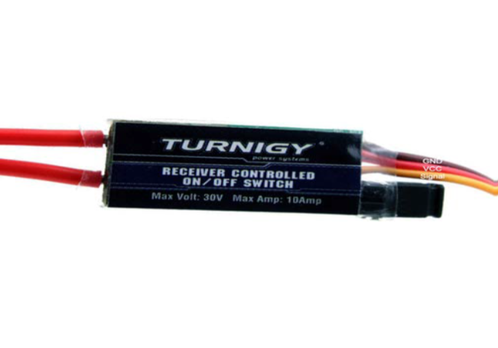
Controlling Camera Gimbal using ESP8266
3 wires – Pins of the Servo motor:
Yellow (Signal) – RC7 of ArduPilot
Red – +
Camera’s Data Cable
Tick – USBs +
GND – USBs –
2 wires – Battery (External)

Slide 18
Controlling Camera Gimbal using ESP8266
Gimbal with two-servo motors controlled remotely
Requirements
1. Servo Brcaket (To install the servos)
2. ESP8266 or NodeMCU
3. Two-serco motors (SG90 mini gear micro servo)
4. 5V power supply
5. Smart Phone
6. Router (for Wi-Fi connection)

Slide 19
Controlling Camera Gimbal using ESP8266
Procedure
1. Attach the servos to the bracket. Connect the servos to the
ESP82866.

Slide 20
Controlling Camera Gimbal using ESP8266
2. Servos are connected to the GPIO pins of ESP82866.
It connect with GPIO-0 and GPIO-2 or D3 and D4.
3. To Write the code for ESP82866.
a. Open Blynk App and create a New Project.
b. Provide Project Name
c. From Choose device, select NodeMCU or ESP82866.
d. Provide the authentication code for the Project which
sent our Email.

Slide 21
Controlling Camera Gimbal using ESP8266
4. Get the Widget Box and Choose Slider.
5. Provide Slider Name (Servo-1, Servo-2)
and Select a Virtual Pin (V1&V6)
for them.

Slide 22
Controlling Camera Gimbal using ESP8266
6. Write the Code in Arduino IDE
a. Include header files
#define BLYNK_PRINT Serial
#include <SPI.h>
#include <BlynkSimpleEsp82866.h>
#include <Servo.h>
#include <ESP82866WiFi.h>
b. Install ESP82866 Libraries.

Slide 23
Controlling Camera Gimbal using ESP8266
c. Provide the authentication code for the project (from Email), and
WiFi Name and Password for connection by
char auth[] = “*********”;
char ssid[] = “**********”;
char pass[] = “**********”;
d. Declare the Servos Servo s1, s2;
e. Initialize Setup, Blynk, and Servo Pins
Serial.begin(9600);
Blynk.begin(auth, ssid, pass)
s1.attach(0);
s2.attach(2);

Slide 24
Controlling Camera Gimbal using ESP8266
f. Assign the virtual pins of the Blynk
BLYNK_WRITE(V1)
{
s1.write(param.asInt());
}
BLYNK_WRITE(V6)
{
s2.write(param.asInt());
}

Slide 25
Controlling Camera Gimbal using ESP8266
g. Run the Blynk
In void loop() function insert the line
Blynk.run();
h. Verify and upload the code after connecting NodeMCU to the
computer.
i. From Blynk App, Run the Project. Now we will see the Slider as
j. Move the Slider Left and Right,
we will see the Servo will move 0⁰-180⁰

Slide 26
Flying and Taking Shots
Lock the altitude and fly parallel to the ground.
Using a camera remote controller or mobile App is easy.
If use the switch, need to open and connect the drone to the
MissionPlanner via Telemetry.
Go to the ‘Flight Data’, right click on the map,
select “Trigger Camera Now” option, which will trigger the
‘Camera Shutter Button’ and start recording or take a photo.
5. To take Selfie, Using the Timer execute the step-4 in a locked state.

Slide 27
Video Quality Improvement
Reduce the Jello effect – To balancing all the propellers and motor thrust use soft rubber, foam, or silicon plugs while mounting the camera to the drone.
Set RC_Feel parameter to a lower number (20/40) to reduce jerky camera movement at initial stage.
Shutter speed can be 1/6 sec or slower for properly exposed images.
Adjust the brightness by camera lens filters in sunny day.
Follow the shapes or natural phenomenon or man-made structures from the sky and take pictures.

Slide 28
Thank You
&
Queries?

